Slide 1
Foundations
Week 1 – Genesis: Trinity and
Attributes of God

Slide 2
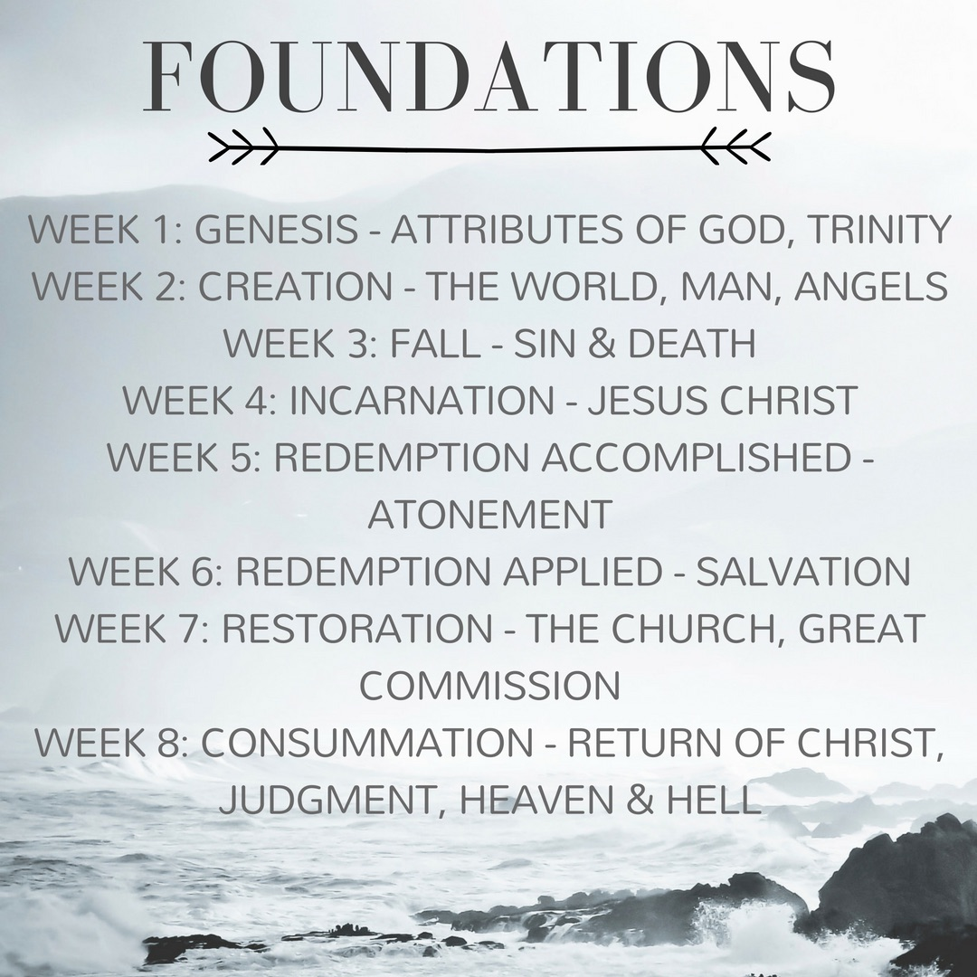

Slide 3
2 Peter 1:5-7
"For this very reason, make every effort to supplement your faith with virtue, and virtue with knowledge, and knowledge with self-control, and self-control with steadfastness, and steadfastness with godliness, and godliness with brotherly affection, and brotherly affection with love.”

Slide 4
Trinity
God is three persons
Each person is fully God
There is one God

Slide 5
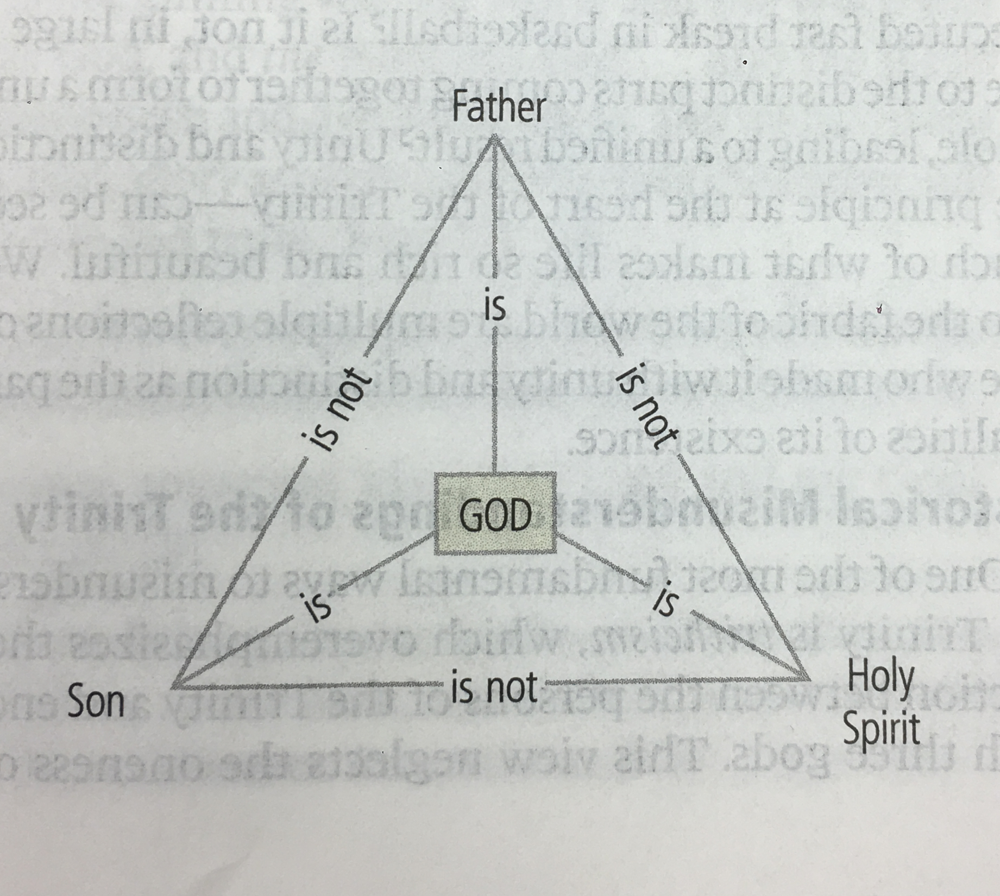

Slide 6
John 1:1-2
“In the beginning was the Word, and the Word was with God, and the Word was God. He was in the beginning with God.”

Slide 7
John 14:26
“But the Counselor, the Holy Spirit, whom the Father will send in My name, He will teach you all things, and will bring to remembrance all that I have said to you.”

Slide 8
Matthew 3:16-17
And when Jesus was baptized, immediately he went up from the water, and behold, the heavens were opened to him, and he saw the Spirit of God descending like a dove and coming to rest on him; and behold, a voice from heaven said, “This is my beloved Son, with whom I am well pleased.”

Slide 9
Hebrews 1:3, 8
He is the radiance of the glory of God and the exact imprint of his nature
v. 8: But of the Son he says, “Your throne, O God, is forever and ever…”

Slide 10
Acts 5:3-4
But Peter said, “Ananias, why has Satan filled your heart to lie to the Holy Spirit…? You have not lied to man but to God.”

Slide 12
Eternality
God has always existed, having no beginning and no end, and experiencing no succession of moments.

Slide 13
Psalm 90:2
Before the mountains were brought forth, or ever Your hand had formed the earth and the world, from everlasting to everlasting, You are God.

Slide 14
Job 36:26
The number of His years is unsearchable.

Slide 15
Psalm 90:4
For a thousand years in your sight are but as yesterday when it has passed, or as a watch in the night.

Slide 16
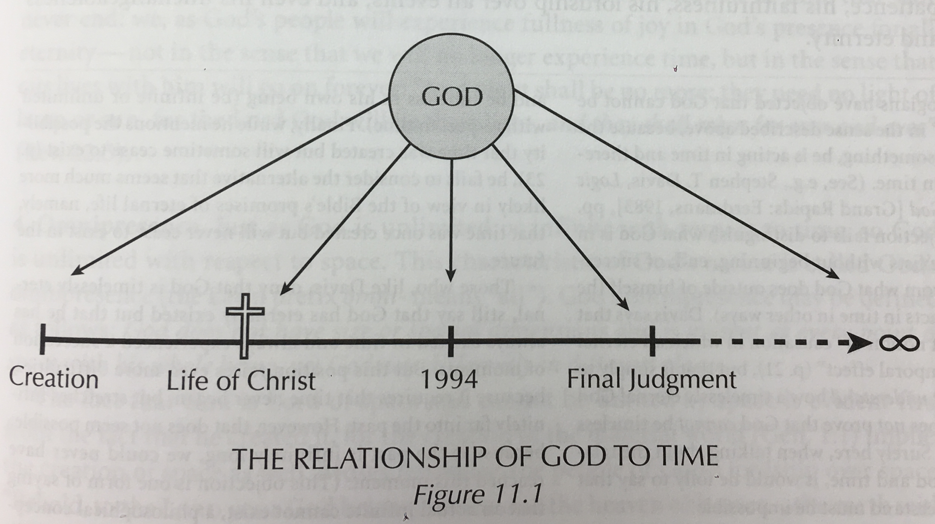

Slide 18
Immutability
God does not change in His being and in His perfections.

Slide 19
Psalm 102:25-27
        “Of old you laid the foundation of the earth, and the heavens are the work of your hands. They will perish, but you endure; they will all wear out like a garment. You change them like raiment, and they pass away; but you are the same, and your years have no end.”

Slide 20
James 1:17
Every good gift and every perfect gift is from above, coming down from the Father of lights with whom there is no variation or shadow due to change.

Slide 21
Malachi 3:6
For I, the Lord, do not change; therefore you, O sons of Jacob, are not consumed.

Slide 22
Isaiah 46:9-11
I am God, and there is none like me, declaring the end from the beginning and from ancient times things not yet done, saying ‘My counsel shall stand, and I will accomplish all my purpose’…I have spoken, and I will bring it to pass; I have purposed, and I will do it

Slide 23
Isaiah 43:6
Bring them from afar, all of my Sons and My Daughters, all those who are called by my name, whom I created for my glory.

Slide 24
Isaiah 48:9-11
For my name’s sake I defer my anger, for the sake of my praise I restrain it for you, that I may not cut you off…For my own sake, for my own sake, I do it, for how should my name be profaned? My glory I will not give to another.

Slide 26
Omnipresence
God has no size or shape and is present in all places with His entire being.

Slide 27
Psalm 139:7-10
Where shall I go from Your Spirit? Or where shall I flee from Your presence? If I ascend to heaven, you are there! If I make my bed in Sheol, you are there! If I take the wings of the morning and dwell in the uttermost parts of the sea, even there your hand shall lead me, and your right hand shall hold me.

Slide 28
Amos 9:1-4
Not one of them shall flee away, not one of them shall escape. Though they dig into Sheol, from there shall my hand take them; though they climb up to heaven, from there I will bring them down. Though they hide themselves on the top of Carmel, from there I will search out and take them; and though they hide from my sight at the bottom of the sea, there I will command the serpent, and it shall bite them. And though they go into captivity before their enemies, there I will command the sword, and it shall slay them; and I will set my eyes upon them for evil and not for good.

Slide 30
Love
God eternally gives of Himself to others for their joy.

Slide 31
1 John 4:10
In this is love, not that we loved God but that He loved us and sent His Son to be the propitiation for our sins.

Slide 32
Romans 5:8
God shows His love for us in that while we were yet sinners, Christ died for us.

Slide 33
Galatians 2:20
And the life I now live in the flesh I live by faith in the Son of God, who loved me and gave himself for me.

Slide 35
Wisdom
God always chooses the best goals and the best means to those goals.

Slide 36
Psalm 104:24
O Lord, how manifold are your works! In wisdom have you made them all; the earth is full of your creatures.

