Slide 1
Foundations
Week 5 – Redemption Applied:
Salvation

Slide 2
Order of Salvation (Ordo Salutis)
Election
Effectual Call
Regeneration
Conversion
Justification
Adoption
Sanctification
Perseverance
Glorification

Slide 3
Election
Election is an act of God before creation in which he chooses some people to be saved, not on account of any foreseen merit in them, but only because of His sovereign good pleasure.

Slide 4
Acts 13:48
“And when the Gentiles heard this they were glad and glorified the word of God; and as many as were ordained to eternal life believed.”

Slide 5
Ephesians 1:4-6
“He chose us in him before the foundation of the world that we should be holy and blameless before him. He destined us in love to be his sons through Jesus Christ, according to the purpose of his will, to the praise of his glorious grace.”

Slide 6
1 Thessalonians 1:4-5
“For we know, brethren beloved by God, that he has chosen you; for our gospel came to you not only in word, but also in power and in the Holy Spirit and with full conviction”

Slide 7
2 Thessalonians 2:13
“We are bound to give thanks to God always for you, brethren beloved by the Lord, because God chose you from the beginning to be saved through sanctification by the Spirit and belief in the truth.”

Slide 8
Romans 9:11-13
“Though they were not yet born and had done nothing either good or bad, in order that God’s purpose of election might continue not because of works but because of his call, she was told, ‘The elder will serve the younger.’ As it is written, ‘Jacob I loved, but Esau I hated.’”

Slide 9
2 Timothy 1:9
“[God has] saved us and called us with a holy calling, not in virtue of our works but in virtue of his own purpose and the grace which he gave us in Christ Jesus ages ago.”

Slide 10
Romans 8:30
“Those whom he predestined he also called; and those whom he called he also justified.”

Slide 11
Effectual Call
Effective calling is an act of God the Father, speaking through the human proclamation of the Gospel, in which he summons people to himself in such a way that they respond in saving faith.

Slide 12
1 Corinthians 1:9
“God is faithful, by whom you were called into the fellowship of his Son Jesus Christ our Lord.”

Slide 13
John 6:44
”No one can come to me unless the Father who sent me draws him.”

Slide 14
When God calls people in this powerful way, he calls them “out of darkness into his marvelous light” (1 Peter 2:9); he calls them “into the fellowship of his Son” (1 Cor. 1:9; Acts 2:39) and “into his own kingdom and glory” (1 Thess. 2:12; 1 Peter 5:10; 2 Peter 1:3). People who have been called by God “belong to Jesus Christ” (Rom. 1:6). They are called to “be saints” (Rom. 1:7; 1 Cor. 1:2), and have come into a realm of peace (1 Cor. 7:15; Col. 3:15), freedom (Gal. 5:13), hope (Eph. 1:18; 4:4), holiness (1 Thess. 4:7), patient endurance of suffering (1 Peter 2:20–21; 3:9), and eternal life (1 Tim. 6:12).

Slide 15
2 Thessalonians 2:14
“To this he called you through our gospel so that you may obtain the glory of our Lord Jesus Christ.”

Slide 16
Romans 10:14
“How are they to believe in him of whom they have never heard?”

Slide 17
Order of Salvation
Election
Effectual Call

Slide 18
Regeneration
Regeneration is a secret act of God in which he imparts new spiritual life to us. This is sometimes called “being born again.”

Slide 19
Ephesians 2:5
“even when we were dead in our trespasses and sins, God made us alive together with Christ (by grace you have been saved).”

Slide 20
Colossians 2:13
“When you were dead in your transgressions and the uncircumcision of your flesh, He made you alive together with Him, having forgiven us all our trespasses.”

Slide 21
1 Peter 1:23, 25
“You have been born anew not of perishable seed but of imperishable, through the living and abiding word of God…That word is the good news which was preached to you.”

Slide 22
James 1:18
        “He chose to give us birth through the word of truth.”

Slide 23
John 3:8
“The wind blows where it wills, and you hear the sound of it, but you do not know from where it comes or where it goes; so it is with everyone who is born of the Spirit.”

Slide 24
Order of Salvation
Election
Effectual Call
Regeneration

Slide 25
Conversion
Conversion is our willing response to the gospel call, in which we sincerely repent of our sins and place our trust in Christ for salvation.

Slide 26
Romans 10:14
“How can they believe in him of whom they have never heard?”

Slide 27
Romans 1:32
“Though they know God’s decree that those who do such things deserve to die, they not only do them but approve of those who practice them.”

Slide 28
John 3:2
        “Rabbi, we know that you are a teacher come from God; for no one can do these signs that you do, unless God is with him.”

Slide 29
Acts 20:21
“solemnly testifying to both Jews and Greeks of repentance to God and of faith in our Lord Jesus Christ.”

Slide 30
Acts 17:30
“The times of ignorance God overlooked, but now he commands all men everywhere to repent.”

Slide 31
Order of Salvation
Election
Effectual Call
Regeneration
Conversion

Slide 32
Romans 8:30
“Those whom he predestined he called, and those whom he called he also justified.”

Slide 33
Justification
Justification is an instantaneous legal act of God in which he things of our sins as forgiven and Christ’s righteousness as belonging to us, and declares us to be righteous in his sight.

Slide 34
Romans 8:30
“There is therefore now no condemnation for those who are in Christ Jesus.”

Slide 35
Romans 8:33-34
“Who shall bring any charge against God’s elect? It is God who justifies; who is to condemn?”

Slide 36
Romans 4:5
“And to the one who does not work, but trusts in him who justifies the ungodly, his faith is reckoned to him as righteousness.”

Slide 37
Romans 4:3
“Abraham believed God and it was reckoned to Him as righteousness.”

Slide 38
Romans 4:5
“And to the one who does not work, but trusts in him who justifies the ungodly, his faith is reckoned to him as righteousness.”

Slide 39
2 Corinthians 5:21
”He made him who knew no sin to be sin for us, so that we might become the righteousness of God in him.”

Slide 40
Order of Salvation
Election
Effectual Call
Regeneration
Conversion
Justification

Slide 41
Adoption
Adoption is an act of God whereby he makes us members of His family. This occurs after our conversion and is an outcome of our saving faith.

Slide 42
Romans 8:14-17
“For all who are led by the Spirit of God are sons of God. For you did not receive the spirit of slavery to fall back into fear, but you have received the spirit of adoption. When we cry, “Abba! Father!” it is the Spirit himself bearing witness with our spirit that we are children of God and if children, then heirs, heirs of God and fellow heirs with Christ, provided we suffer with him in order that we may also be glorified with him.”

Slide 43
1 John 3:1-2
“See what love the Father has given us, that we should be called children of God; and so we are…Beloved, we are God’s children now.”

Slide 44
Order of Salvation
Election
Effectual Call
Regeneration
Conversion
Justification
Adoption

Slide 45
Sanctification
Sanctification is a progressive work of God and man that makes us more and more free from sin and like Christ in our actual lives.

Slide 46
Titus 3:5
“he saved us, not because of righteous things we had done, but because of his mercy. He saved us through the washing of regeneration and renewal by the Holy Spirit.”

Slide 47
Romans 6:19
“Just as you once yielded your members to impurity and to greater and greater iniquity, so now yield your members to righteousness for your sanctification.”

Slide 48
2 Corinthians 3:18
“Put on the new nature, which is being renewed in knowledge after the image of its creator.”

Slide 49
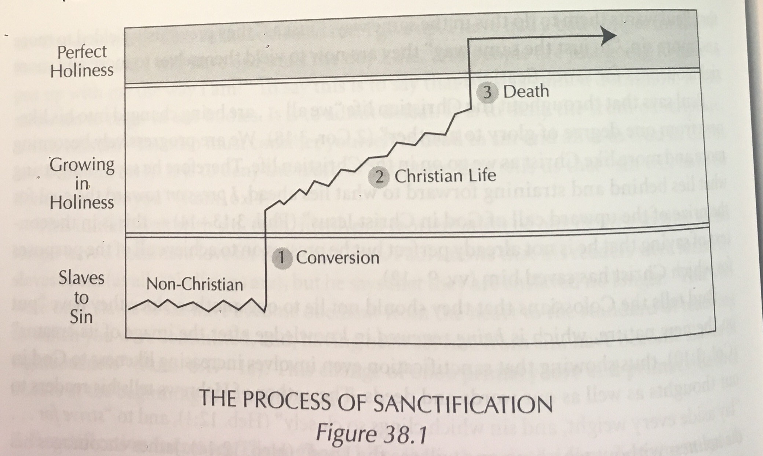

Slide 50
Order of Salvation
Election
Effectual Call
Regeneration
Conversion
Justification
Adoption
Sanctification

Slide 51
Perseverance
Perseverance of the saints means that all those who are truly born again will be kept by God’s power and will persevere as Christians until the end of their lives, and that only those who persevere until the end have been truly born again.

Slide 52
Philippians 1:6
”…being confident of this, that he who began a good work in you will carry it on to completion until the day of Christ.”

Slide 53
Ephesians 1:13-14
“In him you also, who have heard the word of truth, the gospel of your salvation, and have believed in him, were sealed with the promised Holy Spirit which is the guarantee of our inheritance until we acquire possession of it, to the praise of his glory”

Slide 54
John 8:31-32
“Jesus then said to the Jews who had believed in him, ‘If you continue in my word you are truly my disciples.’”

Slide 55
Matthew 10:22
“He who endures to the end will be saved.”

Slide 56
Hebrews 3:14
“We have become partakers of Christ, if we hold fast the beginning of our assurance firm until the end.”

Slide 57
Romans 8:38-39
“For I am sure that neither death nor life, nor angels nor rulers, nor things present nor things to come, nor powers, nor height nor depth, nor anything else in all creation, will be able to separate us from the love of God in Christ Jesus our Lord.”

Slide 58
1 John 2:19
“They went out from us, but they were not of us; for if they had been of us, they would have continued with us; but they went out, that it might be plain that they all are not of us.”

Slide 59
Mark 4:16-17
“when they hear the word, they immediately receive it with joy; and they have no root in themselves, but endure for a while, then when tribulation or persecution arises on account of the word, immediately they fall away.”

Slide 60
Order of Salvation
Election
Effectual Call
Regeneration
Conversion
Justification
Adoption
Sanctification
Perseverance

Slide 61
Glorification
Glorification is the final step in the application of redemption. It will happen when Christ returns and raises from the dead the bodies of all believers for all time who have died, and reunites them with their souls, and changes the bodies of all believers who remain alive, thereby giving all believers at the same time perfect resurrection bodies like his own.

Slide 62
1 Corinthians 15:22-23
“So also in Christ shall all be made alive. But each in his own order: Christ the first fruits, then at his coming those who belong to Christ.”

Slide 63
1 Corinthians 15:51-52
“Lo! I tell you a mystery. We shall not all sleep, but we shall all be changed in a moment, in the twinkling of an eye, at the last trumpet. For the trumpet will sound, and the dead will be raised imperishable, and we shall be changed.”

Slide 64
Philippians 3:20-21
“But our commonwealth is in heaven, and from it we await a Savior, the Lord Jesus Christ, who will change our lowly body to be like his glorious body by the power which enables him even to subject all thigs to himself.”

Slide 65
1 Corinthians 15:42-44, 49
“What is sown is perishable, what is raised is imperishable. It is sown in dishonor, it is raised in glory. It is sown in weakness, it is raised in power. It is sown a physical body, it is raised a spiritual body …. Just as we have borne the image of the man of dust, we shall also bear the image of the man of heaven.”

Slide 66
Order of Salvation
Election
Effectual Call
Regeneration
Conversion
Justification
Adoption
Sanctification
Perseverance
Glorification

