Slide 1
Foundations
Week 8 – Consummation:
Return of Christ, Judgment, Heaven & Hell

Slide 2
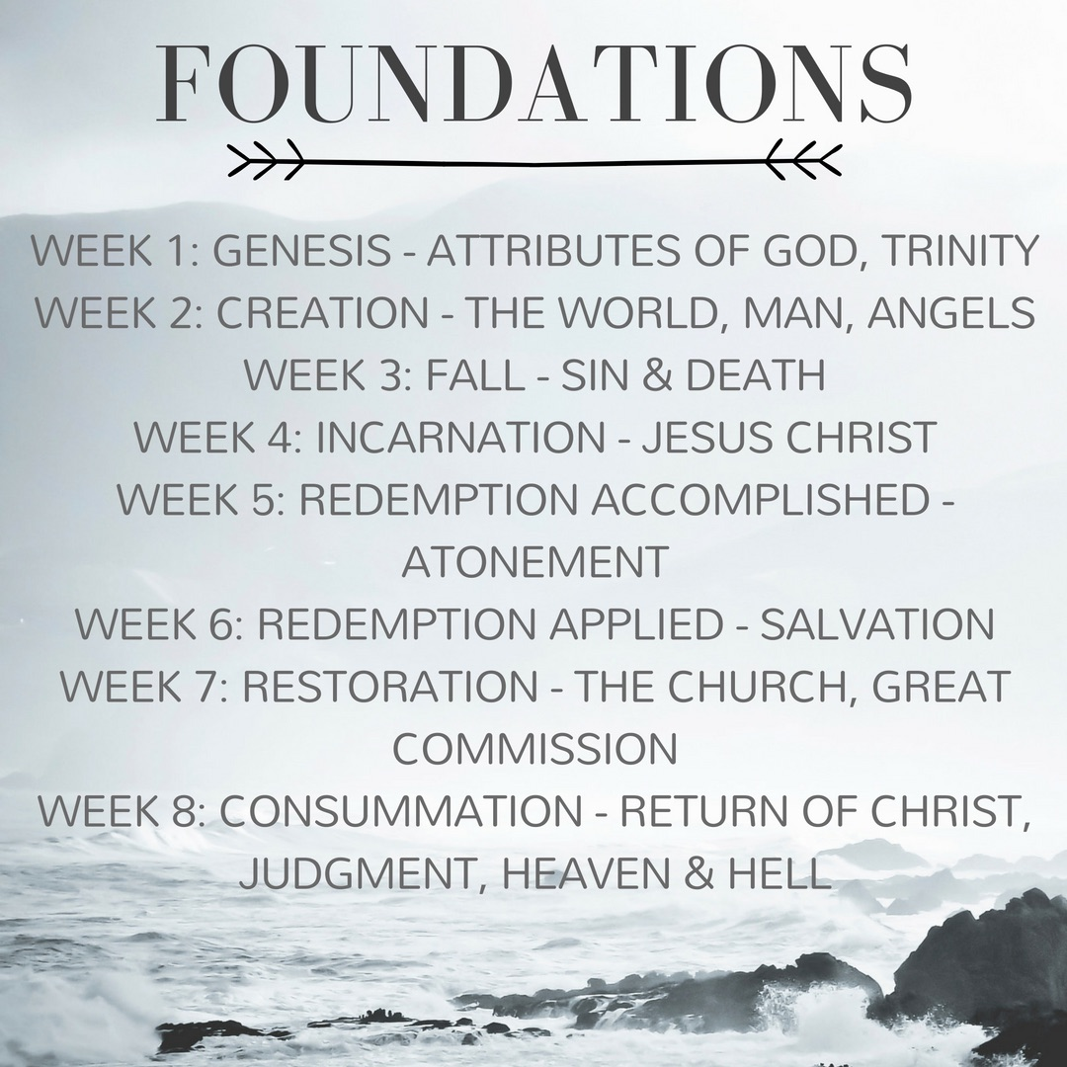

Slide 3
Matthew 24:30
“Then will appear the sign of the Son of Man in heaven. And then all the peoples of the earth will mourn when they see the Son of Man coming on the clouds of heaven, with power and great glory.”

Slide 4
Matthew 26:64
“But I say to all of you: From now on you will see the Son of Man sitting at the right hand of the Mighty One and then coming on the clouds of heaven.”

Slide 5
John 14:3
”I will come again and will take you to be with me so that where I am you will be also.”

Slide 6
Acts 1:11
“Men of Galilee…why do you stand here looking into the sky? This same Jesus, who has been taken from you into heaven, will come back again in the same way that you have seen him go into heaven.”

Slide 7
Hebrews 9:28
“Christ will appear a second time, not to deal with sin but to save those who are eagerly waiting for him.”

Slide 8
Revelation 22:20
“’Surely I am coming soon,’ Amen. Come, Lord Jesus!”

Slide 9
1 Thessalonians 4:16
“…the Lord himself will come down from heaven.”

Slide 10
Acts 1:11
“Men of Galilee…why do you stand here looking into the sky? This same Jesus, who has been taken from you into heaven, will come back again in the same way that you have seen him go into heaven.”

Slide 11
Matthew 24:44
“The Son of Man is coming at an hour that you do not expect.”

Slide 12
Matthew 25:13
“Watch therefore, for you know neither the day nor the hour.”

Slide 13
Mark 13:32-33
“But of that day or that hour no one knows, not even the angels in heaven, nor the Son, but only the Father. Take heed, watch; for you do not know when the time will come.”

Slide 14
1 Thessalonians 4:16
“For the Lord Himself will come down from heaven, with a loud command, with the voice of the archangel and with the trumpet call of God…”

Slide 15
1 Thessalonians 2:19-20
“For who is our hope or joy or crown of exultation? Is it not even you, in the presence of our Lord Jesus at His coming? For you are our glory and joy.”

Slide 16
Revelation 20:11-12
“Then I saw a great white throne and him who was seated on it. The earth and the heavens fled from his presence, and there was no place for them. And I saw the dead, great and small, standing before the throne, and books were opened. Another book was opened, which is the book of life.”

Slide 17
Revelation 20:13-15
“The dead were judged according to what they had done as recorded in the books. The sea gave up the dead that were in it, and death and Hades gave up the dead that were in them, and each person was judged according to what they had done. Then death and Hades were thrown into the lake of fire. The lake of fire is the second death. Anyone whose name was not found written in the book of life was thrown into the lake of fire.”

Slide 18
Revelation 20:13
“The sea gave up the dead that were in it, and death and Hades gave up the dead that were in them, and each person was judged according to what they had done.”

Slide 19
Romans 14:10, 12
“We will all stand before the judgment seat of God…each of us shall give account of himself to God.”

Slide 20
John 5:28-29
        “…a time is coming when all who are in their graves will hear his voice and come out—those who have done what is good will rise to live, and those who have done what is evil will rise to be condemned.”

Slide 21
Acts 24:15
“I have the same hope in God as these men themselves have, that there will be a resurrection of both the righteous and the wicked.”

Slide 22
Revelation 20:12-13
“The dead were judged according to what they had done as recorded in the books…and each person was judged according to what they had done.”

Slide 23
Colossians 2:14
“Having canceled the record of debt, which stood against us and condemned us; he has taken it away, nailing it to the cross.”

Slide 24
Romans 8:3-4
“For God has done what the law, weakened by the flesh, could not do. By sending his own Son in the likeness of sinful flesh and for sin, he condemned sin in the flesh, in order that the righteous requirement of the law might be fulfilled in us.”

Slide 25
2 Corinthians 5:21
        “He made Him who knew no sin to be sin for us, so that we might become the righteousness of God in Him.”

Slide 26
John 5:22, 27
“Moreover, the Father judges no one, but has entrusted all judgment to the Son…And He has given Him authority to judge because he is the Son of Man.”

Slide 27
2 Timothy 4:1
“Jesus Christ is to judge the living and the dead.”

Slide 28
Matthew 25:41
“Then he will say to those on his left, ‘Depart from me, you who are cursed, into the eternal fire prepared for the devil and his angels.”

Slide 29
Revelation 20:10
“The devil who had deceived them was thrown into the lake of fire and Sulphur where the beast and the false prophet were, and they will be tormented day and night for ever and ever.”

Slide 30
Luke 16:22-24
“The rich man also died and was buried; and in Hades, being in torment, he lifted up his eyes, and saw Abraham far off and Lazarus in his bosom, and he called out, “Father Abraham, have mercy upon me, and send Lazarus to dip the end of his finger in water and cool my tongue; for I am in anguish in this flame.”

Slide 31
Luke 16:28
“…for I have five brothers, so that he may warn them, lest they also come into this place of torment.”

Slide 32
Matthew 25:46
“Then they will go away into eternal punishment, and the righteous into eternal life.”

Slide 33
Isaiah 66:24
“Then they will go forth and look on the corpses of the men who have transgressed against Me. For their worm will not die and their fire will not be quenched; and they will be an abhorrence to all mankind."

Slide 34
1 John 3:17
“He will inflict vengeance on those who do not know God and do not obey the gospel of our Lord Jesus. They will suffer the penalty of eternal destruction, separated from the presence of the Lord and the glory of His might.”

Slide 35
Ezekiel 48:35
“And the name of the city from that time on will be: the Lord is there."

Slide 36
John 14:2
“I go to prepare a place for you.”

Slide 37
Acts 1:11
“This Jesus, who was taken up from you into heaven, will come in the same way as you saw him go into heaven.”

Slide 38
Matthew 26:29
“I tell you, I will not drink of this fruit of the vine from now on until the day I drink it anew with you in my Father’s Kingdom.”

Slide 39
Revelation 22:1
“The river of the water of life will flow from the throne of God and of the Lamb through the middle of the street of the city.”

Slide 40
Revelation 22:2
“The tree of life will bear twelve kinds of fruit, yielding its fruit each month.”

Slide 41
Revelation 21:27
“But nothing unclean will ever enter it, nor anyone who does what is detestable or false.”

Slide 42
Matthew 13:43
“Then the righteous will shine like the sun in the kingdom of their Father.”

Slide 43
Revelation 22:3
“No longer will there be any curse. The throne of God and of the Lamb will be in the city, and his servants will serve him.”

Slide 44
Romans 8:20-21
“For the creation was subjected to futility, not willingly, but because of him who subjected it, in hope that the creation itself will be set free from its bondage to corruption and obtain the freedom of the glory of the children of God.”

Slide 45
Revelation 21:23
“The city has no need of sun or moon to shine on it, for the glory of God gives it light, and its lamp is the Lamb.”

