Slide 1
Foundations
Week 1 – Bibliology: The Bible

Slide 2
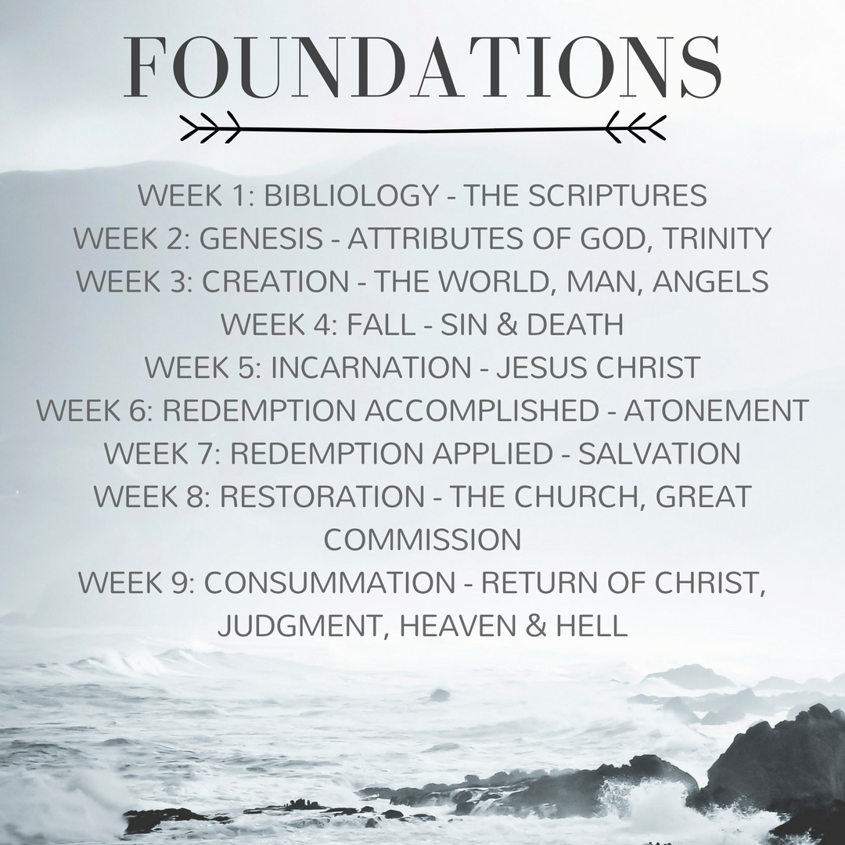

Slide 3
John 18:38
“What is truth?”

Slide 4
The Baptist Faith and Message
“[The Bible] is a perfect treasure of divine instruction. It has God for its author, salvation for its end, and truth, without any mixture of error, for its matter. Therefore, all Scripture is totally true and trustworthy.”

Slide 5
The Bible
From Greek, biblos, meaning “book.”
66 books total
  Old Testament = 39 books
  New Testament = 27 books

Slide 6
The Bible
Law – Leviticus & Deuteronomy
Historical – Ezra & Acts
Poetry – Psalms & Ecclesiastes
Prophecy – Isaiah and Revelation
Biographical – Matthew and John
Epistles – Philippians & Ephesians

Slide 7
The Bible
Written over a span of 1500 years
3 different languages (Hebrew, Aramaic, Greek)
40 different authors
Various cultures, countries, and backgrounds
Diverse, yet unified in message and content

Slide 8
Inspiration
A term referring to the fact that the words of Scripture are spoken by God.

Slide 9
2 Timothy 3:16
“All Scripture is breathed out by God and is profitable for teaching, for reproof, for correction, and for training in righteousness…”

Slide 10
2 Peter 1:21
“No prophecy was ever produced by the will of man, but men spoke from God as they were carried along by the Holy Spirit.”

Slide 11
Authority
All the words of the Bible are God’s words, therefore it is completely truthful and authoritative and must be submitted to.

Slide 12
Matthew 4:4
“Man shall not live by bread alone but by ever word that proceeds from the mouth of God.”

Slide 13
Acts 1:16
“Brothers, the Scripture had to be fulfilled, which the Holy Spirit spoke beforehand by the mouth of David concerning Judas, who became a guide to those who arrested Jesus.”

Slide 14
Titus 1:2
“This truth gives them confidence that they have eternal life, which God—who does not lie—promised them before the world began.”

Slide 15
Hebrews 6:17-18
“In the same way God, desiring even more to show to the heirs of the promise the unchangeableness of His purpose, interposed with an oath, so that by two unchangeable things, in which it is impossible for God to lie, we who have taken refuge would have strong encouragement to take hold of the hope set before us.”

Slide 16
2 Samuel 7:28
“You are God and Your words are true.”

Slide 17
John 17:17
“Sanctify them in the truth; Your word is truth.”

Slide 18
Necessity
The Bible is necessary for knowing the Gospel, for maintaining spiritual life, and for knowing certain aspects of God’s will.

Slide 19
Romans 10:13-14, 17
        “How then will they call on Him in whom they have not believed? How will they believe in Him whom they have not heard? And how will they hear without a preacher?...So faith comes from hearing, and hearing by the word of Christ.”

Slide 20
Matthew 4:4
“Man does not live by bread alone, but by every word that proceeds from the mouth of God.”

Slide 21
1 Peter 2:2
“Like newborn babes, long for the pure spiritual milk, that by it you may grow up to salvation.”

Slide 22
1 Thessalonians 4:3
”This is the will of God for you, your sanctification.”

Slide 23
1 Thessalonians 5:18
“Give thanks in all circumstances, for this is God’s will for you.”

Slide 24
Sufficiency
The Scriptures contain all the words that we need in order to find salvation, grow in obedience to the Lord, and live the lives God desires for us.

Slide 25
2 Timothy 3:15-17
“…from childhood you have been acquainted with the sacred writings, which are able to make you wise for salvation through faith in Christ Jesus. All Scripture is breathed out by God and profitable for teaching, for reproof, for correction, and for training in righteousness, that the man of God may be complete, equipped for every good work.”

Slide 26
Matthew 7:12
“So in everything that you do, do unto others as you would have them do unto you, for this is the Law and the Prophets.”

Slide 27
Acts 17:11
“[The Bereans] were of more noble character than those in Thessalonica, for they received the message with great eagerness and examined the Scriptures every day to see if what Paul said was true.”

Slide 28
Clarity
The Bible is written in such a way that its teachings are able to be understood by all who read it seeking God’s help and being willing to follow it.

Slide 29
2 Peter 3:15-16
“So also our beloved Paul wrote to you according to the wisdom given him, speaking of this as he does in all his letters. There are some things in them that are hard to understand, which the ignorant and unstable twist to their own destruction, as they do the other scriptures.”

Slide 30
Deuteronomy 6:6-7
“And these words I command you this day shall be upon your heart; and you shall teach them diligently to your children, and shall talk of them when you sit in your house, and when you walk by the way, and when you lie down, and when you rise.”

Slide 31
Psalm 19:7
“The testimony of the Lord is sure, making wise the simple.”

Slide 32
Psalm 119:130
“The unfolding of your words gives light; it imparts understanding to the simple.”

Slide 33
1 Corinthians 2:14
”The unspiritual man does not receive the things of the Spirit of God, for they are folly to him, and he is not able to understand them because they are spiritually discerned.”

Slide 34
H.E.A.R. Journals

Slide 35
Hebrews 4:12
“For the word of God is living and active, sharper than any two-edged sword, piercing to the division of soul and of spirit, of joints and of marrow, and discerning the thoughts and intentions of the heart.”

Slide 36
Highlight
After reading a passage of Scripture, highlight each verse that speaks to you by copying it down.

Slide 37
Explain
At this stage you will explain what the text means.

Slide 38
Explain
Why was this written?
To whom was it originally written?
How does it fit with the verses before and after it?
Why did the Holy Spirit include this passage in the book?
What is He intending to communicate through this text?

Slide 39
Apply
How can this help me?
What does this mean today?
What would the application of this verse look like in my life?
What does this mean to me?
What is God saying to me?

Slide 40
Respond
Write a call to action
Describe how you will be different
Indicate what you are going to do
Write a prayer to God

Slide 41
Psalm 119:1
“How blessed are those whose way is blameless, who walk in the law of the Lord.”

Slide 42
Psalm 119:89
“Forever, O Lord, your word is settled in heaven.”

Slide 43
Psalm 119:105
“Your word is a lamp to my feet and a light to my path.”

Slide 44
Psalm 119:142
“Your righteousness is an everlasting righteousness, and Your word is truth.”

Slide 45
Psalm 119:151
“You are near, O Lord, and all Your commandments are truth.”

Slide 46
Psalm 119:160
“The sum of Your word is truth, and every one of Your righteous ordinances is everlasting.”

